Slide 1
De-escalating youth
Ofc. Joshua R. Wallace, Northampton POlice

Slide 2
WhaT IS A CRISIS?
A crisis is a state of feeling; an internal experience of confusion and anxiety to the degree that formerly successful coping mechanisms fail us and ineffective decisions and behaviors take their place. As a result, the person in crisis may feel confused, vulnerable, anxious, afraid, angry, guilty, hopeless and helpless. Perceptions often are altered and memory may be distorted

Slide 3
Concepts to remember
1. Reasoning with an angry person is not possible, the first and only objective is to reduce the level of agitation so that reasoning becomes possible.
2.. De-escalation techniques are abnormal and require practice to become proficient

Slide 4
Teen brain
In teen’s brains, the connections between the emotional part of the brain and the decision-making center are still developing—and not always at the same rate. That’s why when teens have overwhelming emotional input, they can’t explain later what they were thinking. They weren’t thinking as much as they were feeling.

Slide 5
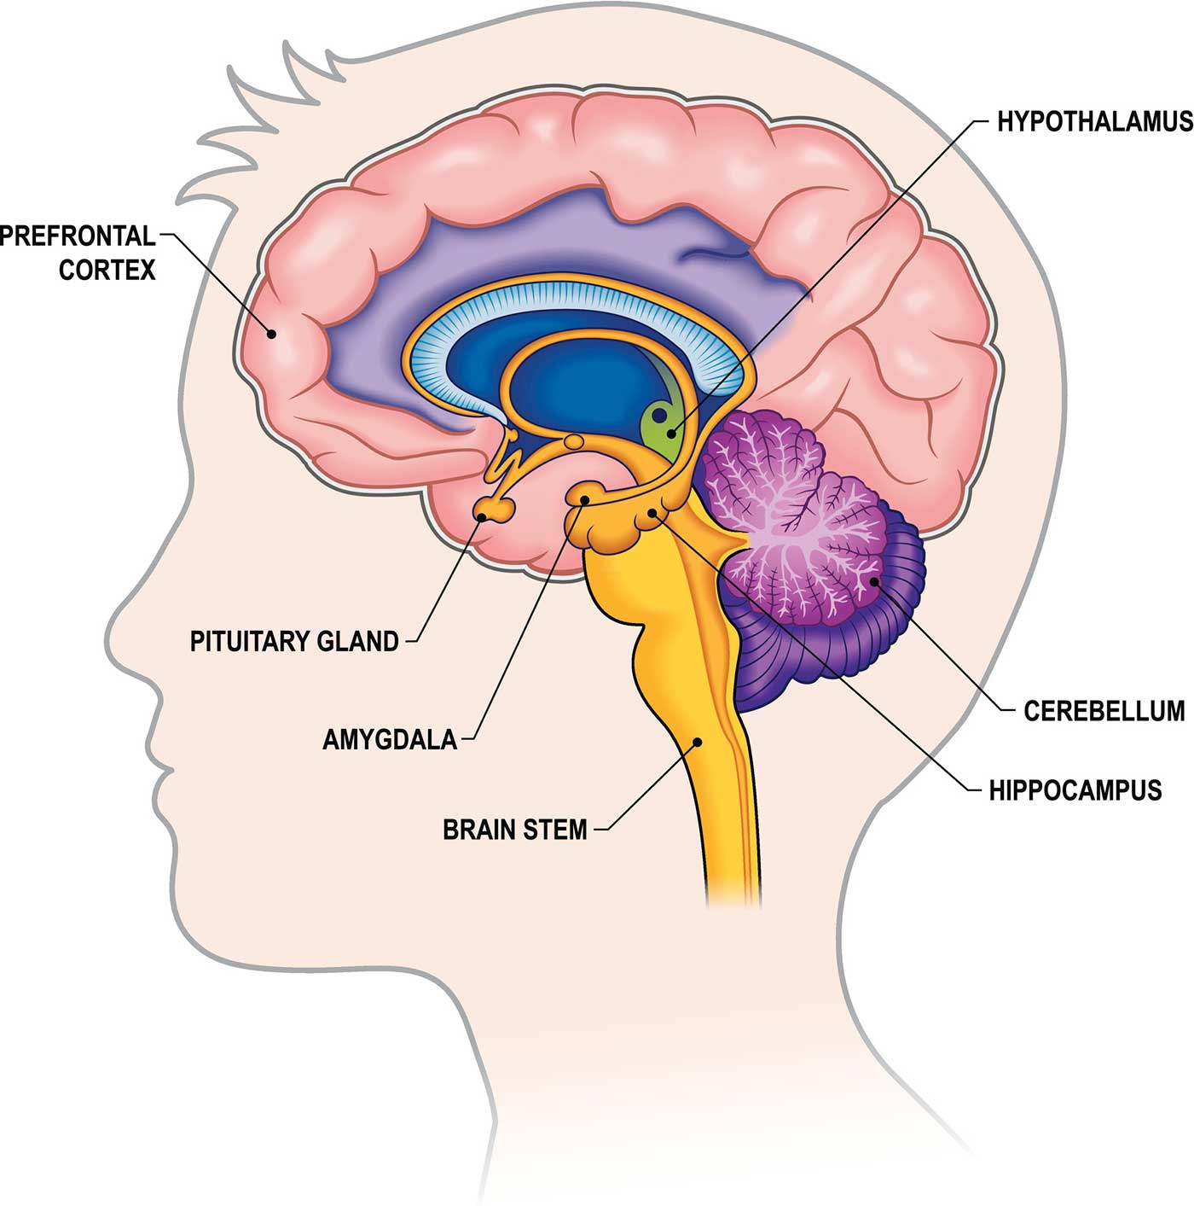

Slide 6


Slide 7
Establish Rapport
Common Verbiage
Lowered posture
Non judgmental
Find common interests
BE HONEST

Slide 8
De-escalation
The Massachusetts Police Officer Standards and Training Commission now requires de-escalation and disengagement tactics, techniques and procedures and other alternatives to the Use of Force for minor children.
The goal is to calm or resolve a situation peacefully and provide alternatives to arrest.
Any Law Enforcement Officer involved in a situation with a minor child should remain calm, engage the minor child in dialogue, and attempt to gain cooperation and trust from the minor child whenever safe and feasible.
When appropriate and feasible, Law Enforcement Officers should approach a minor child in a manner that is slower and more deliberate than a Law Enforcement Officer would approach an adult in order to begin a process of de-escalation and to encourage and build trust.

Slide 9
What does this look like
Remove audience / issue shelter in place / lockdown protocol
  necessary?
Begin to try and build rapport, state you are there to help
Slow down your actions and language
Use active listening, see places you can validate emotions but not behaviors
  How a child is feeling is not wrong, even if their behavior was/is – there is a difference
Break down expectations and look for places you can praise the expectations
Provide choices wherever and whenever it is possible and safe to do so
Use nonthreatening verbal and body language

Slide 10
Three Basic Listening Modes
Competitive or Combative
Passive or Attentive
Active or Reflective

Slide 11
Competitive or Combative Listening
happens when we are more interested in promoting our own point of view than in understanding or exploring someone else’s view. We either listen for openings to take the floor, or for flaws or weak points we can attack. As we pretend to pay attention we are impatiently waiting for an opening, or internally formulating our rebuttal.

Slide 12
In Passive or Attentive Listening
we are genuinely interested in hearing and understanding the other person’s point of view. We are attentive and passively listen. We assume that we heard and understand correctly. but stay passive and do not verify it.

Slide 13
Active or Reflective Listening
is the single most useful and important listening skill. In active listening, we are also genuinely interested in understanding what the other person is thinking, feeling, wanting, or what the message means, and we are active in checking out our understanding before we respond with our own new message.

Slide 14
Active or Reflective Listening
We restate or paraphrase our understanding of their message and reflect it back to the sender for verification. This verification or feedback process is what distinguishes active listening and makes it effective.

Slide 15
Clarifying Communication
We all act and respond on the basis of our understanding, and too often there is a misunderstanding that neither of us is aware of. With active listening, if a misunderstanding has occurred, it will be known immediately, and the communication can be clarified before any further misunderstanding occurs.

Slide 16
Several other possible benefits occur with active listening:
Sometimes a person just needs to be heard and acknowledged before the person is willing to consider an alternative or soften his /her position
It helps people to spot the flaws in their reasoning when they hear it played back without criticism.
It also helps identify areas of agreement so the areas of disagreement are put in perspective and are diminished rather than magnified.

Slide 17
Emotional release
If feelings are intense, it is not a good time to try to negotiate or problem solve with a subject. Rather attention needs to be paid to helping the subject reduce the intensity of his/her feelings so that they may engage in rational thinking.
Intense Emotions
Rational thinking

Slide 18
Avoiding common mistakes
Authoritative v. Calming tones: Use a restrained show of force. Allow uniform, badge etc… establish the strong presence.
Use positioning to achieve containment.
Listen more than you speak: “You have two ears and one mouth, use them proportionately.”

Slide 19
Emotional population
Since the brain is not fully developed the brain functions on pure emotion leaving juveniles susceptible to over-emotional responses to stimuli.

Slide 20
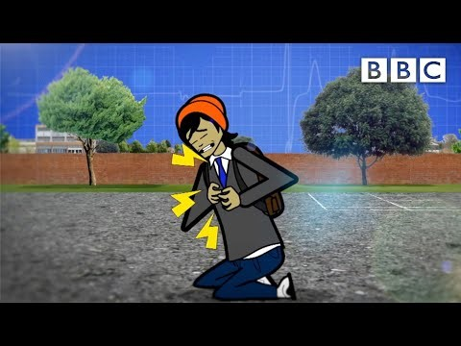

Slide 21
Calming the storm
Make physical contact (Hands or elbows)
Speak softly and calm
Eliminate unnecessary stimuli
“Be here”, grounding
Breathing techniques

Slide 22
Breathing techniques
Box Breathing
Double inhale
Crisis breathing
Belly breathing

Slide 23
Goals of C.I.T.
Crisis intervention focuses on:
  Engaging the subject in active listening;
  Zeroing in on workable solutions;
  Minimizing

Slide 24
“Time cools, time clarifies, no mood can be maintained quite unaltered through the course of hours.”
Mark Twain

